Slide 1
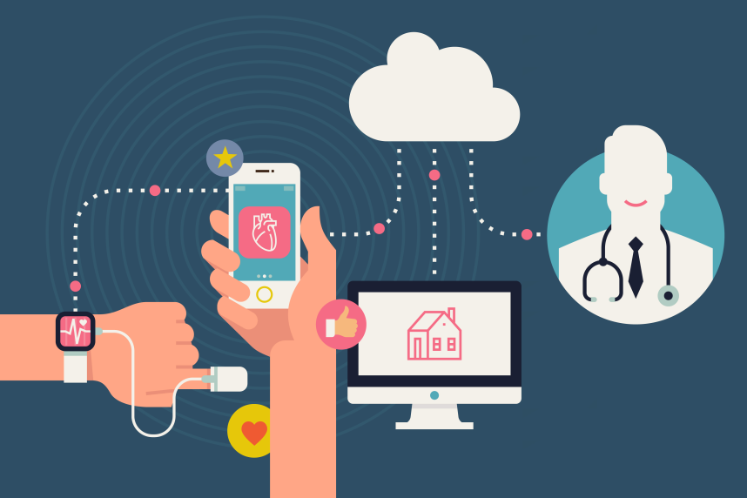
Quantified Self in FPC de Oostvaarderskliniek

Slide 2
Introduction
Naomi de Koning
Policy department, FPC (forensisch psychiatrisch centrum ) de Oostvaarderskliniek, DJI, Ministry of Justice
Stefania Rosanio
Senior consultant strategy DJI
Project leider Proeftuin “Quantified Self”, part of the program “Toekomstvast DJI”

Slide 3
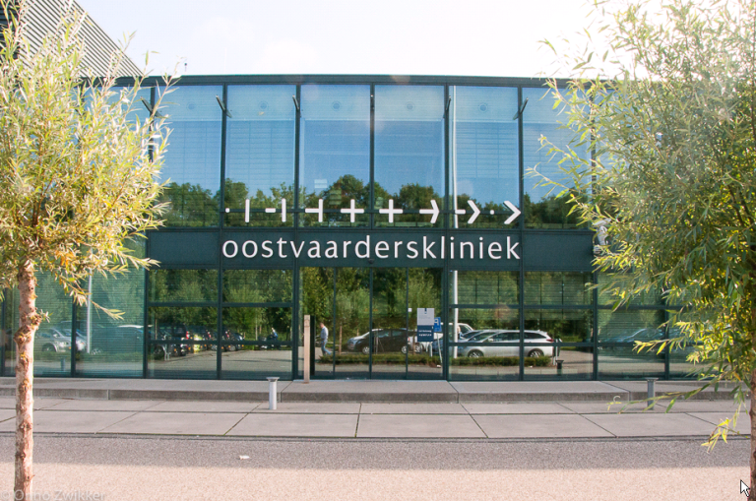
FPC de Oostvaarderskliniek (OVK)
Forensic Psychiatrisch centrum (non-private)
Based in Almere since 2008
Psychiatric hospital for people on whom a court has imposed detention under a hospital order.
+/- 320 staff members
140 patients (intramural)
+/- 50 patients (extramural)
Mostly male patients (5 female patients)
Average ages: 40

Slide 4
Disorders
Most patients that are treated at the OVK have one ore more of the following disorders:
- Personality disorders
- Psychotic disorders
- Autism spectrum disorders
- The abuse of or a dependence on substances
These disorders are often accompanied by sexually unacceptable and deviant behaviour and/or (verbal or physical) aggression towards others and our patients display symptoms of different psychological disorders.

Slide 5
Proeftuin QS
OVK wants to:
improve treatments for patients
shorten the treatment period
Technical innovations like Quantified Self might help us with these goals.
Patients can become aware of their emotional reactions and behaviour during tension/stress, by wearing a device that measures certain parameters (physiological feedback).
Patients can learn to recognize these emotional reactions and behaviour during tension/stress.
Patients can learn to recognize these reactions and behaviour and learn (through therapy and guidance) how to regulate them (coping mechanisms)

Slide 6
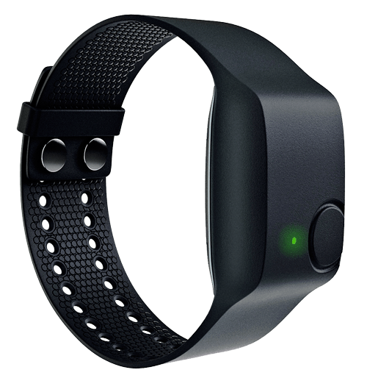
Design
Period: may 2016 – july 2016
Device: Empatica E4. During the testperiod patients took care of the devices themselves (charging, cleaning)
Participation: voluntarily, but patients were rewarded at the end of the testperiod (15 euro)
Diary (for background information)
Patients: 2 differents groups were (44 patients, 7 participated)
1 group psychotic, autism or attention (ADHD) disorder
1 group personality disorder
Data upload: every two or three days by staffmembers

Slide 7
Results
 | Sex | Age | Diary | Group | Motivation patient
A | M | 53 | Y | Psychotic/autism/ADHD | High, took initiative to wear device. Wore device for several days. Unfortunately transferred to a different group.
B | M | 33 | N | Psychotic/autism/ADHD | High, patient knows he has problems with tension and recognises this. Wants to wear to actually see what happens. Wore device for several times for several days.
C | M | 45 | Y | Psychotic/autism/ADHD | High, wants to help other patients with their tension/agression problems. Doesn’t recognise his own tensions and when it happens he doesn’t recognises it as tension/agression. Didn’t keep a diary, but wrote down a report of his workday (when he wore the device).
D | M | 48 | Y | Psychotic/autismADHD | Very high, wants to prove that the observations of the staff members aren’t right, it’s what they want to see (subjective). The device is more objective and will show something else according to the patient. In his opinion, he doesn’t experience tensions and when he does it’s because of excercise or high temperature or just sweating. Wore the device every day for three months.
E | M | 45 | N | Psychotic/autism/ADHD | High, wants to help other patients with their tension/agression problems. Thinks he recognises his own tensions more than enough. Wore the device for serveral times for several days.
F | M | 54 | Y | Personality | High, thinks it’s interesting and wants to show that he’s aware of his tensions. People tell him that he doesn’t show a lot emotions. He wants to show that the data on the device matches with what he says he feels (and shows). Wore the device for serveral times for several days.
G | M | 28 | N | Personality | High, hopes to get insight in the built-up of his tension. Wore the device for serveral times for several days. Found it diffucult to keep a journal. He decided not to keep one, even after the staff member offered him to help him.

Slide 8
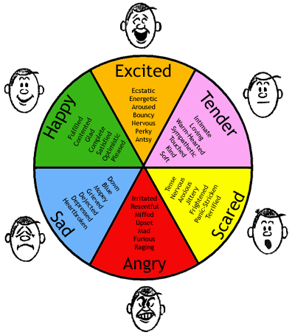
Results
The devices, but in combination with diary, led to more and better contact between patients and staffmembers
Patients talked more about feelings, emotions, stress, and different situations that happened during the day.
Patients were at first very interested and motivated (for different reasons) to wear the devices
However during the test, the motivation decreased
The device wasn’t that interesting anymore
Problems with the device
Data from device (sometimes) showed something the patient didn’t want to hear (no ‘proof’)
Data from device didn’t match the diary/ observations of patient or staff → distrusting the devices (patients)
Feedback took to long (no direct feedback for patients, staffmembers sometimes to busy because of other work)

Slide 9
Results
QS has a added value in the treatment of TBS patients. In combination with the diaries, the quality of the contact between staff members and patients improved. Patients opened up more about their emotions, stresslevels and about different situations that happened during the day.
However in order to shorten the treatment period with the help of QS
→ more research is needed
Notes:
Advice:
1) different research design
during therapy session (i.e. PMT or agression therapy)
→ activate agressive or stressfull behaviour in a patient in a controlled setting (while wearing the device)
→ discuss patients observations, therapists observations and compare these with the data (direct feedback)
→ learn patient how to recognize this behaviour
→ learn patient copingmechanisms
2) devices with direct feedback for patients

Slide 10
Thank you!

